Slide 1
News Classification
Using NLP and Machine learning techniques

Slide 2
Team Members
LCI2020059 Sai Deepika Reddy
LCI2020078 Vivek Vardhan
LCI2020079 B.Srikanth

Slide 3
OVERVIEW::
Introduction
Dataset
Problem Statement
Methodology
Experimental Setup
Results
References

Slide 4
Introduction:
News Classification is a type of Text Classification, which is also called text tagging or Text categorization. Text Classification is the process of categorizing the text into Organized groups.
By using NLP(Natural Language Processing), text classifiers can automatically analyze text and then assign a set of pre-defined tags or categories based on its content.
And there are also various applications of text classification. Some of them are Sentiment Analysis, Topic Detection, Language Detection, Tagging products/ content, Differentiating between legitimate messages and spam mails, news portals and many more.

Slide 5
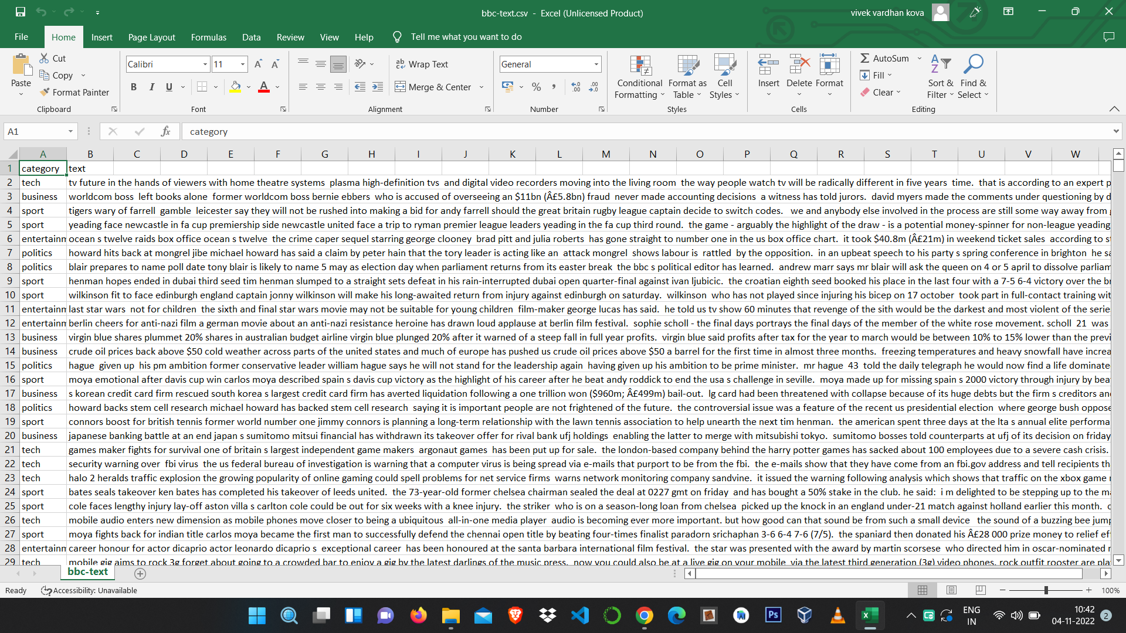
Data set : BBC news dataset
We are having two columns [category and text]

Slide 6
Problem Statement:
The problem we are going to put in is BBC news Classification.
Where our primary goal is to build a system that can accurately classify previously unseen news articles into the right category.

Slide 7
Methodology:
Step-1 Collecting the BBC news Dataset.
Step-2 Cleaning the data to get pre-processed data.
Step-3 Label Encoding the preprocessed data.
Step-4 TF-IDF
Step-5 Passing through various ML models.
Step-6 Using Ensemble Method
Step-7 Passing through K-fold cross validation

Slide 8
TF-IDF
TF-IDF stands for “Term Frequency — Inverse Document Frequency”. This is a technique to quantify words in a set of documents
TF-IDF can be broken down into two parts TF (term frequency) and IDF (inverse document frequency).
Term frequency works by looking at the frequency of a particular term you are concerned with relative to the document
Inverse document frequency looks at how common (or uncommon) a word is amongst the corpus

Slide 9
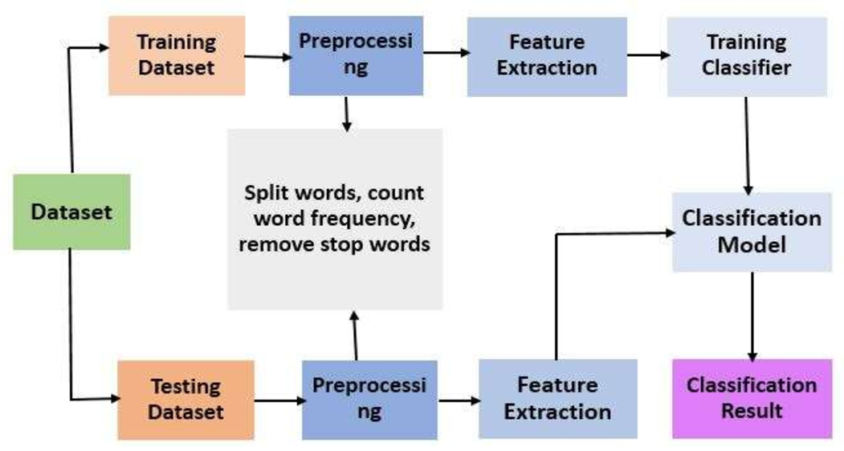
Experimental Setup:

Slide 10
Ensemble Methods
We created three ensemble models by using different machine learning models
First model was created by taking maximum voting of logistic regression , KNN and Naive Bayes and we got accuracy 96.40%
Second model was created by taking maximum voting of Support vector Machine , Random Forest and Ridge Classifier and we got accuracy 96.85%
Third model was created by taking maximum voting of logistic regression ,Naive Bayes ,Support vector Machine , Random Forest and Ridge Classifier and we got accuracy 96.85%

Slide 11
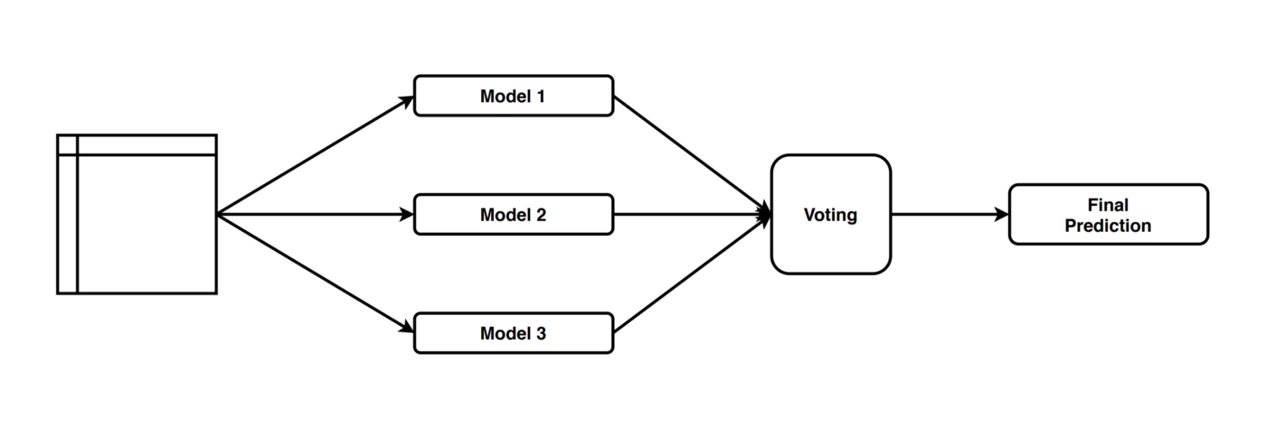

Slide 12
K-fold Cross validation
We used k-fold cross validation technique by taking k value as 5
For each learning set, the prediction function uses k-1 folds, and the rest of the folds are used for the test set.
The training data is divided in to 5 datasets and for every dataset we predicted the accuracy.
The Final accuracy was taken by average of every accuracy.

Slide 13
Bert Model
BERT is an acronym for Bidirectional Encoder Representations from Transformers
BERT base, which is a BERT model consists of 12 layers of Transformer encoder.

Slide 14
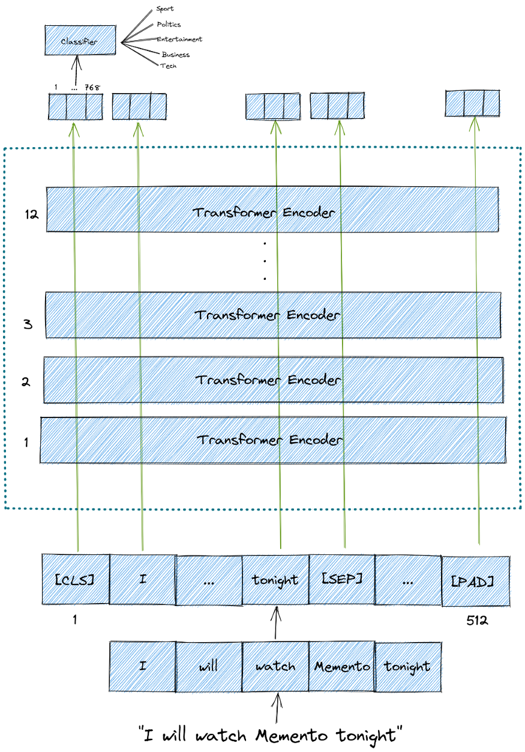

Slide 15
Results:
.
MODEL NAME | ACCURACY RATE
Logistic Regression Model | 96.3%
Naive Bayes Model | 90.5%
KNN | 95.0%
Decision Tree Model | 84.7%
Ridge Classifier | 96.8%
Support Vector Machine | 96.1%
Random Forest | 95.7%

Slide 16
Reference:
DataSet: https://www.kaggle.com/code/yufengdev/bbc-text-categorization/data
TF-IDF: https://medium.com/analytics-vidhya/tf-idf-term-frequency-technique-easiest-explanation-for-text-classification-in-nlp-with-code-8ca3912e58c3

